Slide 1
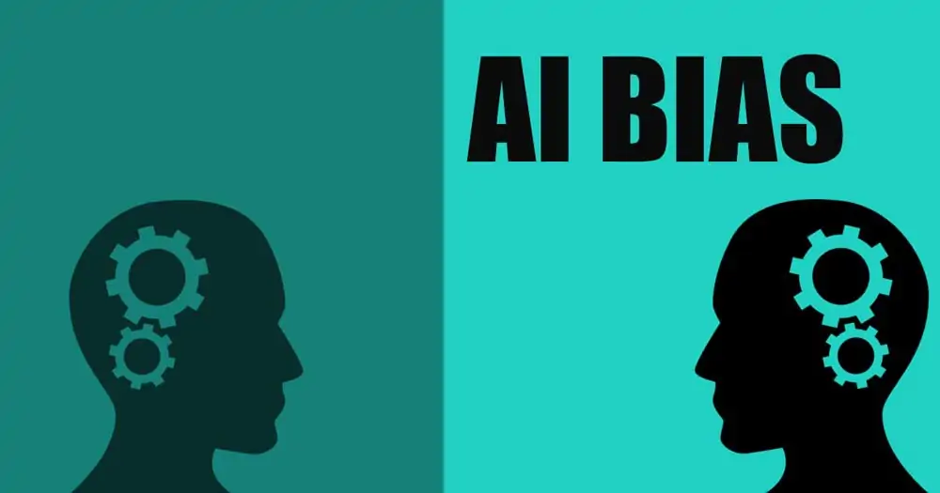

Slide 2
AI Bias is prevalent but preventable
Here’s how to root it out
Article by Jacob Shomron, Iterate.ai Aug 8,2021

Slide 3
“Through 2030 85% of AI projects will provide false results caused by bias” (Gartner report 2018)
AI applications are largely dependant on training data, but also depend on AI engineers passing on their latent biases.
We have seen examples of obvious bias (Daniel’s presentation about the LA Police AI), but bias is often more subtle.
We must continually detect and eliminate human bias from AI.

Slide 4
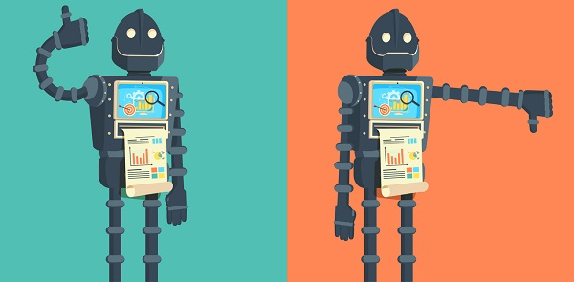
The stakes are high
Faulty AI leads to costly failures for businesses making AI-based decisions
It can also lead to serious reputational damage:
It can even lead to life threatening situations when failing to flag a disease.
Notes:
Business decisions:
Wrong business strategy
Sub-optimal recruitment
Poor logistics
Reputational damage:
Discrimintory AI for loan applications
Racist AI in face recognition

Slide 5

Bias free AI is an ethical responsibility, and also a business/trust opportunity for organizations.

Slide 6
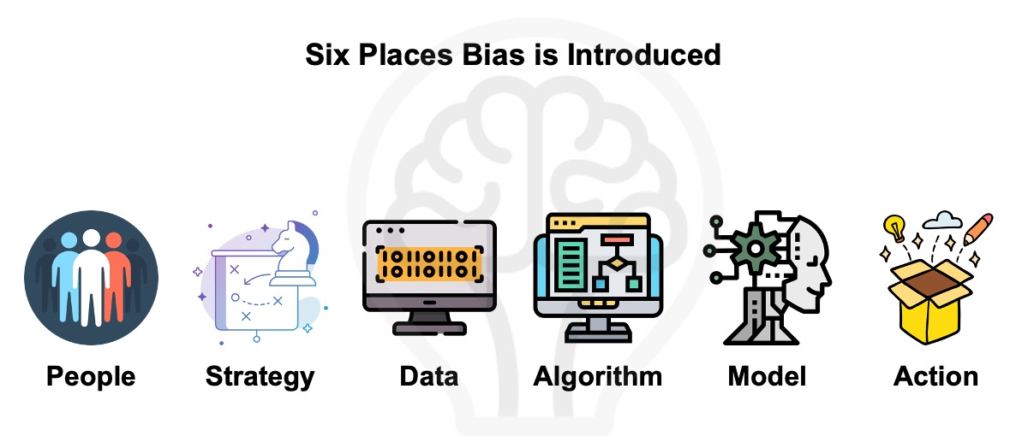
Where does bias come from?
Notes:
Cognitive bias at the very start of the strategy
Engineers allowing their own world views to influence algorithm
Datasets limited to certain demographics or focal points
Implementation of the AI

Slide 7
Identifying and mitigating AI bias
Orgainzations need to proactively assess AI for bias, issues and blind spots in data, and adjust accordingly.
This can be achieved through:
- frameworks
- toolkits
- processes
- policies
Open source tooling can assist in testing AI for bias.

Slide 8
AI Frameworks
Frameworks will introduce checks and balances to minimize bias
Benchmarks for bias-free practices can be automated
Some examples:
The Aletheia Framework from Rolls Royce: 32-step process for designing/managing AI
Deloitte’s AI framework: 6 essential dimansions for safeguarding AI and ethical practices
Naveen Joshi’s framework: focus on explainability, conscious development and smart regulations

Slide 9
AI Toolkits
Practical tools that can be leveraged to eliminate bias at different levels.
Some examples:
AI Fairness 360 from IBM: examine, report and mitigate discrimination and bias
IBM Watson OpenScale: real-time bias detection and mitigation, and enables explainability/trust.
Google’s What-If Tool: visualization of machine learning model behavior, allows to test trained models against fairness metrics.

Slide 10
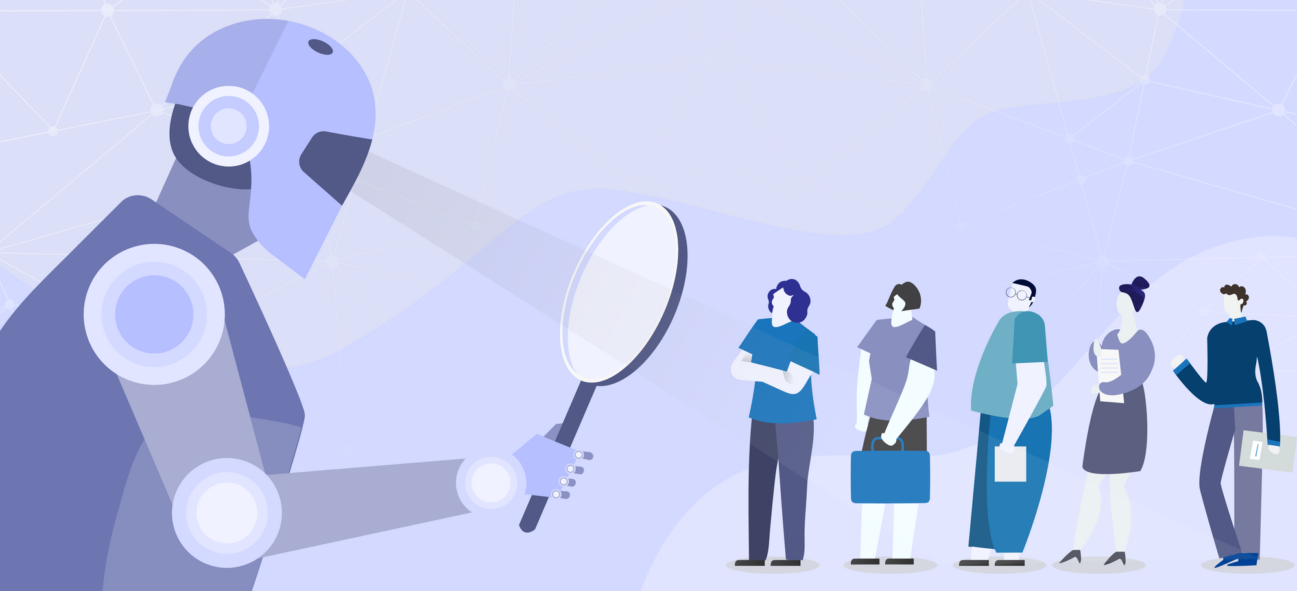
Processes and policies
Organizations, and teams on all levels will need to introduce new processes and policies:
Defining bias metrics
Regularly and thoroughly checking data against metrics
Establish governance
Require strict vigilance

